Slide 1
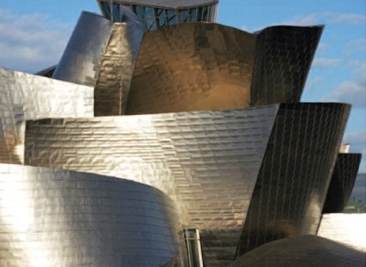
William Stallings Computer Organization and Architecture 10th Edition
Notes:
Lecture slides prepared for “Computer Organization and Architecture”, 10/e, by William Stallings, Chapter 1 “Introduction”.

Slide 2
Chapter 1
Basic Concepts and Computer Evolution
Notes:
In a class of computers called microcomputers, the relationship between architecture
and organization is very close. Changes in technology not only influence
organization but also result in the introduction of more powerful and more complex
architectures. Generally, there is less of a requirement for generation-
To-generation compatibility for these smaller machines. Thus, there is more interplay between
organizational and architectural design decisions. An intriguing example of this is
the reduced instruction set computer (RISC), which we examine in Chapter 15.
This book examines both computer organization and computer architecture.
The emphasis is perhaps more on the side of organization. However, because a
computer organization must be designed to implement a particular architectural
specification, a thorough treatment of organization requires a detailed examination
of architecture as well.

Slide 3
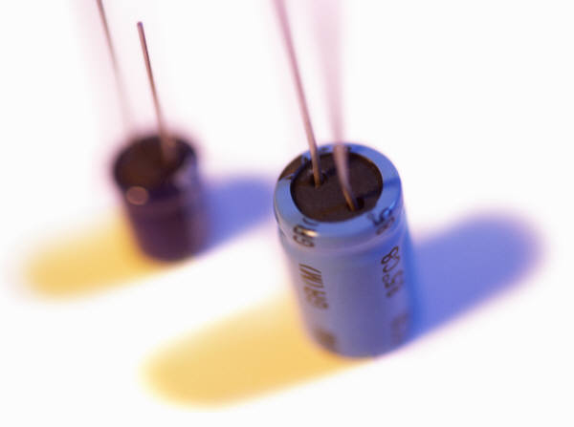
History of Computers
Second Generation: Transistors
Smaller
Cheaper
Dissipates less heat than a vacuum tube
Is a solid state device made from silicon
Was invented at Bell Labs in 1947
It was not until the late 1950’s that fully transistorized computers were commercially available
Notes:
The first major change in the electronic computer came with the replacement of
the vacuum tube by the transistor. The transistor is smaller, cheaper, and dissipates
less heat than a vacuum tube but can be used in the same way as a vacuum tube to
construct computers. Unlike the vacuum tube, which requires wires, metal plates, a
glass capsule, and a vacuum, the transistor is a solid-state device, made from silicon.
The transistor was invented at Bell Labs in 1947 and by the 1950s had launched
an electronic revolution. It was not until the late 1950s, however, that fully transistorized
computers were commercially available. The use of the transistor defines
the second generation of computers.

Slide 4
Table 1.2 Computer Generations
Notes:
It has become widely accepted to classify computers into generations based on the fundamental
hardware technology employed (Table 1.2). Each new generation is characterized
by greater processing performance, larger memory capacity, and smaller
size than the previous one.

Slide 5
Second Generation Computers
Introduced:
More complex arithmetic and logic units and control units
The use of high-level programming languages
Provision of system software which provided the ability to:
Load programs
Move data to peripherals
Libraries perform common computations
Notes:
But there are other changes as well. The second generation saw the introduction
of more complex arithmetic and logic units and control units, the use of
high-level programming languages, and the provision of system software with the
computer. In broad terms, system software provided the ability to load programs,
move data to peripherals, and libraries to perform common computations, similar
to what modern operating systems like Windows and Linux do.

Slide 6
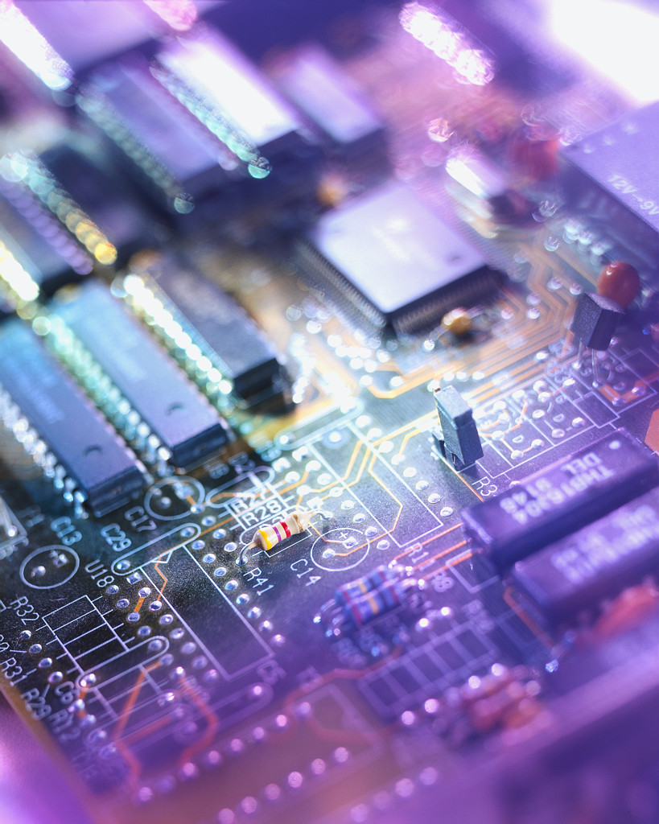
History of Computers
Third Generation: Integrated Circuits
1958 – the invention of the integrated circuit
Discrete component
Single, self-contained transistor
Manufactured separately, packaged in their own containers, and soldered or wired together onto masonite-like circuit boards
Manufacturing process was expensive and cumbersome
The two most important members of the third generation were the IBM System/360 and the DEC PDP-8
Notes:
A single, self-contained transistor is called a discrete component. Throughout the
1950s and early 1960s, electronic equipment was composed largely of discrete components—
transistors, resistors, capacitors, and so on. Discrete components were
manufactured separately, packaged in their own containers, and soldered or wired
together onto masonite-like circuit boards, which were then installed in computers,
oscilloscopes, and other electronic equipment. Whenever an electronic device called
for a transistor, a little tube of metal containing a pinhead-sized piece of silicon
had to be soldered to a circuit board. The entire manufacturing process, from transistor
to circuit board, was expensive and cumbersome.
These facts of life were beginning to create problems in the computer industry.
Early second-generation computers contained about 10,000 transistors. This
figure grew to the hundreds of thousands, making the manufacture of newer, more
powerful machines increasingly difficult.
In 1958 came the achievement that revolutionized electronics and started the
era of microelectronics: the invention of the integrated circuit. It is the integrated
circuit that defines the third generation of computers. In this section, we provide a
brief introduction to the technology of integrated circuits. Then we look at perhaps
the two most important members of the third generation, both of which were introduced
at the beginning of that era: the IBM System/360 and the DEC PDP-8.

Slide 7
Notes:
Microelectronics means, literally, “small electronics.” Since
the beginnings of digital electronics and the computer industry, there has been a
persistent and consistent trend toward the reduction in size of digital electronic
circuits. Before examining the implications and benefits of this trend, we need to
say something about the nature of digital electronics. A more detailed discussion is
found in Chapter 11.
The basic elements of a digital computer, as we know, must perform storage,
movement, processing, and control functions. Only two fundamental types of components
are required (Figure 1.10): gates and memory cells. A gate is a device that
implements a simple Boolean or logical function, such as IF A AND B ARE TRUE
THEN C IS TRUE (AND gate). Such devices are called gates because they control
data flow in much the same way that canal gates control the flow of water. The
memory cell is a device that can store one bit of data; that is, the device can be in
one of two stable states at any time. By interconnecting large numbers of these
fundamental devices, we can construct a computer.

Slide 8
Integrated Circuits
A computer consists of gates, memory cells, and interconnections among these elements
The gates and memory cells are constructed of simple digital electronic components
Data storage – provided by memory cells
Data processing – provided by gates
Data movement – the paths among components are used to move data from memory to memory and from memory through gates to memory
Control – the paths among components can carry control signals
Exploits the fact that such components as transistors, resistors, and conductors can be fabricated from a semiconductor such as silicon
Many transistors can be produced at the same time on a single wafer of silicon
Transistors can be connected with a processor metallization to form circuits
Notes:
We can relate this to our four
basic functions as follows:
• Data storage: Provided by memory cells.
• Data processing: Provided by gates.
• Data movement: The paths among components are used to move data from
memory to memory and from memory through gates to memory.
• Control: The paths among components can carry control signals. For example,
a gate will have one or two data inputs plus a control signal input that activates
the gate. When the control signal is ON, the gate performs its function on the
data inputs and produces a data output. Similarly, the memory cell will store
the bit that is on its input lead when the WRITE control signal is ON and will
place the bit that is in the cell on its output lead when the READ control signal
is ON.
Thus, a computer consists of gates, memory cells, and interconnections among these
elements. The gates and memory cells are, in turn, constructed of simple digital
electronic components.
The integrated circuit exploits the fact that such components as transistors,
resistors, and conductors can be fabricated from a semiconductor such as silicon.
It is merely an extension of the solid-state art to fabricate an entire circuit in a tiny
piece of silicon rather than assemble discrete components made from separate
pieces of silicon into the same circuit. Many transistors can be produced at the same
time on a single wafer of silicon. Equally important, these transistors can be connected
with a process of metallization to form circuits.

Slide 9
Notes:
Figure 1.11 depicts the key concepts in an integrated circuit. A thin wafer of
silicon is divided into a matrix of small areas, each a few millimeters square. The
identical circuit pattern is fabricated in each area, and the wafer is broken up into
chips. Each chip consists of many gates and/or memory cells plus a number of input
and output attachment points. This chip is then packaged in housing that protects
it and provides pins for attachment to devices beyond the chip. A number of these
packages can then be interconnected on a printed circuit board to produce larger
and more complex circuits.

Slide 10
Family Characteristics
Similar or identical instruction set
Similar or identical operating system
Increasing speed
Increasing number of I/O ports
Increasing memory size
Increasing cost
Notes:
The concept of a family of compatible computers was both novel and
extremely successful. A customer with modest requirements and a budget to match
could start with the relatively inexpensive Model 30. Later, if the customer’s needs
grew, it was possible to upgrade to a faster machine with more memory without
sacrificing the investment in already-developed software. The characteristics of a
family are as follows:
• Similar or identical instruction set: In many cases, the exact same set of machine
instructions is supported on all members of the family. Thus, a program that
executes on one machine will also execute on any other. In some cases, the
lower end of the family has an instruction set that is a subset of that of the top
end of the family. This means that programs can move up but not down.
• Similar or identical operating system: The same basic operating system is
available for all family members. In some cases, additional features are added
to the higher-end members.
• Increasing speed: The rate of instruction execution increases in going from
lower to higher family members.
• Increasing number of I /O ports: The number of I/O ports increases in going
from lower to higher family members.
• Increasing memory size: The size of main memory increases in going from
lower to higher family members.
• Increasing cost: At a given point in time, the cost of a system increases in going
from lower to higher family members.
How could such a family concept be implemented? Differences were achieved
based on three factors: basic speed, size, and degree of simultaneity [STEV64]. For
example, greater speed in the execution of a given instruction could be gained by
the use of more complex circuitry in the ALU, allowing suboperations to be carried
out in parallel. Another way of increasing speed was to increase the width of the
data path between main memory and the CPU. On the Model 30, only 1 byte (8 bits)
could be fetched from main memory at a time, whereas 8 bytes could be fetched at
a time on the Model 75.
The System/360 not only dictated the future course of IBM but also had a
profound impact on the entire industry. Many of its features have become standard on
other large computers.

Slide 11
Notes:
In the same year that IBM shipped its first System/360, another
momentous first shipment occurred: PDP-8
from Digital Equipment Corporation(DEC). At a time when the average
computer required an air-conditioned room, the PDP-8
(dubbed a minicomputer by the industry, after the miniskirt of the day)
was small enough that it could be placed on top of a lab bench or be built into
other equipment. It could not do everything the mainframe could, but at $16,000, it
was cheap enough for each lab technician to have one. In contrast, the System/360
series of mainframe computers introduced just a few months before cost hundreds
of thousands of dollars.
The low cost and small size of the PDP-8
enabled another manufacturer to purchase a PDP-8
and integrate it into a total system for resale. These other manufacturers
came to be known as original equipment manufacturers (OEMs) , and the
OEM market became and remains a major segment of the computer marketplace.
In contrast to the central-switched architecture (Figure 1.9) used by IBM on its
700/7000 and 360 systems, later models of the PDP-8
used a structure that became virtually
universal for microcomputers: the bus structure. This is illustrated in Figure 1.13.
The PDP-8 bus, called the Omnibus, consists of 96 separate signal paths, used to carry
control, address, and data signals. Because all system components share a common
set of signal paths, their use can be controlled by the CPU. This architecture is highly
flexible, allowing modules to be plugged into the bus to create various configurations.
It is only in recent years that the bus structure has given way to a structure known as
Point-to-point interconnect, described in Chapter 3.

Slide 12
Semiconductor Memory Microprocessors
LSI
Large
Scale Integration
Later
Generations
VLSI
Very Large Scale Integration
ULSI
Ultra Large
Scale
Integration
Notes:
Beyond the third generation there is less general agreement on defining generations
of computers. Table 1.2 suggests that there have been a number of later generations,
based on advances in integrated circuit technology. With the introduction
of large-scale integration (LSI), more than 1000 components can be placed on a
single integrated circuit chip. Very-large-scale integration (VLSI) achieved more
than 10,000 components per chip, while current ultra-large-scale integration (ULSI)
chips can contain more than one billion components.
With the rapid pace of technology, the high rate of introduction of new products,
and the importance of software and communications as well as hardware, the
classification by generation becomes less clear and less meaningful. In this section,
we mention two of the most important of developments in later generations.

Slide 13
Semiconductor Memory
In 1970 Fairchild produced the first relatively capacious semiconductor memory
Chip was about the size of a single core
Could hold 256 bits of memory
Non-destructive
Much faster than core
In 1974 the price per bit of semiconductor memory dropped below the price per bit of core memory
There has been a continuing and rapid decline in memory cost accompanied by a corresponding increase in physical memory density
Developments in memory and processor technologies changed the nature of computers in less than a decade
Since 1970 semiconductor memory has been through 13 generations
Each generation has provided four times the storage density of the previous generation, accompanied by declining cost per bit and declining access time
Notes:
The first application of integrated circuit technology
to computers was construction of the processor (the control unit and the arithmetic
and logic unit) out of integrated circuit chips. But it was also found that this same
technology could be used to construct memories.
In the 1950s and 1960s, most computer memory was constructed from tiny
rings of ferromagnetic material, each about a sixteenth of an inch in diameter. These
rings were strung up on grids of fine wires suspended on small screens inside the
computer. Magnetized one way, a ring (called a core) represented a one; magnetized
the other way, it stood for a zero. Magnetic-core memory was rather fast; it took as
little as a millionth of a second to read a bit stored in memory. But it was expensive,
bulky, and used destructive readout: The simple act of reading a core erased the data
stored in it. It was therefore necessary to install circuits to restore the data as soon
as it had been extracted.
Then, in 1970, Fairchild produced the first relatively capacious semiconductor
memory. This chip, about the size of a single core, could hold 256 bits of memory. It
was nondestructive and much faster than core. It took only 70 billionths of a second
to read a bit. However, the cost per bit was higher than for that of core.
In 1974, a seminal event occurred: The price per bit of semiconductor memory
dropped below the price per bit of core memory. Following this, there has been a continuing
and rapid decline in memory cost accompanied by a corresponding increase
in physical memory density. This has led the way to smaller, faster machines with
memory sizes of larger and more expensive machines from just a few years earlier.
Developments in memory technology, together with developments in processor technology
to be discussed next, changed the nature of computers in less than a decade.
Although bulky, expensive computers remain a part of the landscape, the computer has
also been brought out to the “end user,” with office machines and personal computers.
Since 1970, semiconductor memory has been through 13 generations: 1K, 4K,
16K, 64K, 256K, 1M, 4M, 16M, 64M, 256M, 1G, 4G, and, as of this writing, 8 Gb
on a single chip (1K = 2¹⁰, 1M = 2²⁰, 1G = 2³⁰). Each generation has provided four
times the storage density of the previous generation, accompanied by declining cost
per bit and declining access time. Densities are projected to reach 16 Gb by 2018 and 32 Gb by 2023
[ITRS14].

Slide 14
Microprocessors
The density of elements on processor chips continued to rise
More and more elements were placed on each chip so that fewer and fewer chips were needed to construct a single computer processor
1971 Intel developed 4004
First chip to contain all of the components of a CPU on a single chip
Birth of microprocessor
1972 Intel developed 8008
First 8-bit microprocessor
1974 Intel developed 8080
First general purpose microprocessor
Faster, has a richer instruction set, has a large addressing capability
Notes:
Just as the density of elements on memory chips has continued
to rise, so has the density of elements on processor chips. As time went on, more
and more elements were placed on each chip, so that fewer and fewer chips were
needed to construct a single computer processor.
A breakthrough was achieved in 1971, when Intel developed its 4004. The
4004 was the first chip to contain all of the components of a CPU on a single chip:
The microprocessor was born.
The 4004 can add two 4-bit numbers and can multiply only by repeated addition.
By today’s standards, the 4004 is hopelessly primitive, but it marked the beginning of
a continuing evolution of microprocessor capability and power.
This evolution can be seen most easily in the number of bits that the processor
deals with at a time. There is no clear-cut measure of this, but perhaps the best measure
is the data bus width: the number of bits of data that can be brought into or sent
out of the processor at a time. Another measure is the number of bits in the accumulator
or in the set of general-purpose registers. Often, these measures coincide, but
not always. For example, a number of microprocessors were developed that operate
on 16-bit numbers in registers but can only read and write 8 bits at a time.
The next major step in the evolution of the microprocessor was the introduction
in 1972 of the Intel 8008. This was the first 8-bit microprocessor and was almost twice
as complex as the 4004.
Neither of these steps was to have the impact of the next major event: the introduction
in 1974 of the Intel 8080. This was the first general-purpose microprocessor.
Whereas the 4004 and the 8008 had been designed for specific applications, the 8080
was designed to be the CPU of a general-purpose microcomputer. Like the 8008, the
8080 is an 8-bit microprocessor. The 8080, however, is faster, has a richer instruction
set, and has a large addressing capability.

